Slide 1
Future Ready Skills Grab Challenge
CHALLENGE: Safety: The Telematics Dataset
Team Members: Choo Weng Yan (Team 9)
Jared
Keith Lee

Slide 2
Table of Contents
1
Exploratory Data Analysis & Data Cleaning
1
Data Preparation & Feature Engineering
2
2
3
Model Building
4
Evaluation

Slide 3
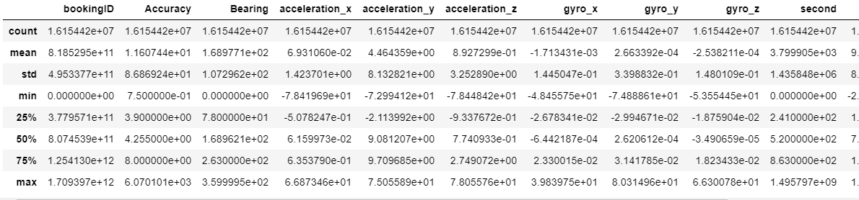
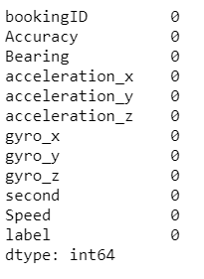
Exploratory Data Analysis
The table at the left shows a brief descriptive statistical summary of the variables in the dataset.
1
All the null values are listed out. It shows that there is not null values in this dataset.
The variables are being classified into two groups which are Categorical Variables and Numerical Variables. It shows that this dataset contains all numeric variables.

Slide 4
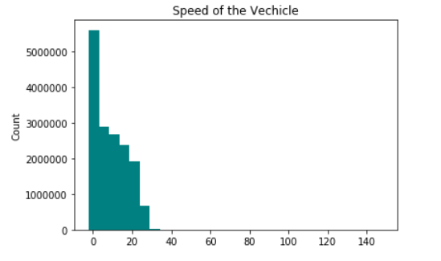
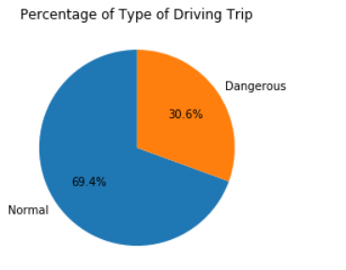
This histogram show the distribution of the speed of the vehicle. It shows the graph is slightly positively skewed and the speed is mainly ranges from 0-40m/s
1
Exploratory Data Analysis
The pie chart shows the Percentage of Type of Driving Trip.
According to the pie chart, it shows that most of the drivers who drive safety (69.4%) and 30.6% of them are driving dangerously.
In conclusion, there are more passengers who drive safely in Singapore.

Slide 5
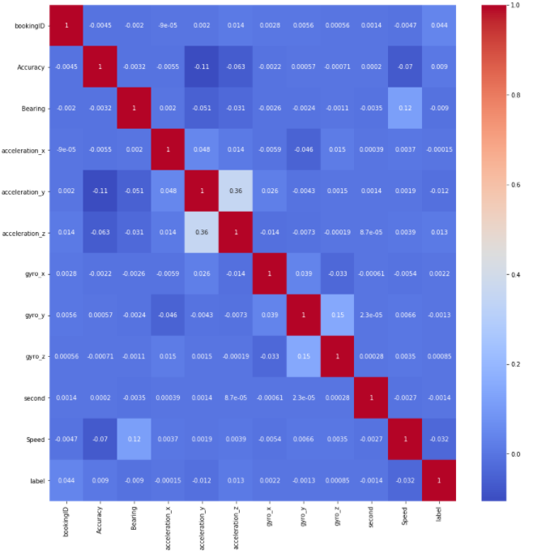
1
Exploratory Data Analysis
The heat map on the left shows the correlation between the variables in the dataset.
According to the heatmap, it shows that ‘acceleration_y’ and ‘acceleration_z’ , ‘gyro_y’ and ‘gyro_z’ has higher correlation compared with other attributes.
Hence, I have decided to look more into the variables.

Slide 6
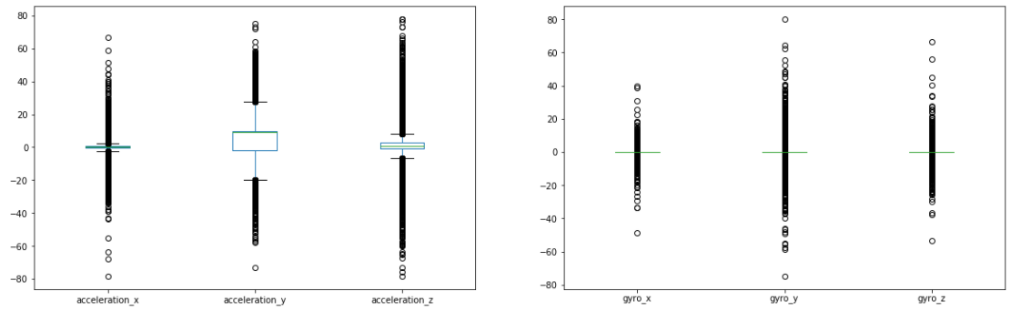
The two box plots above shows the acceleration and orientation of device readings of the device. Based on the first boxplot (left), it shows that acceleration_y has the highest interquartile range and has the highest and lowest accelerometer readings while the acceleration_z has the most outliers. Based on the 2nd boxplot of the right, gyro_y has the most outliers and the outliers ranges from -80 to 80.
Exploratory Data Analysis
1
Boxplot of accelerometer and gyroscope readings on each axis

Slide 7


Data Cleansing
2
Data that contains more than 86400 seconds in the ‘seconds’ column will be removed as it is not possible for a vehicle to drive more than 24 hour non stop.
For the ‘Speed’ column, the data that contains values lesser than 0 will be removed as the speed of the vehicle will be just either 0m/s (which means the vehicle is not moving) or more than 0m/s

Slide 8
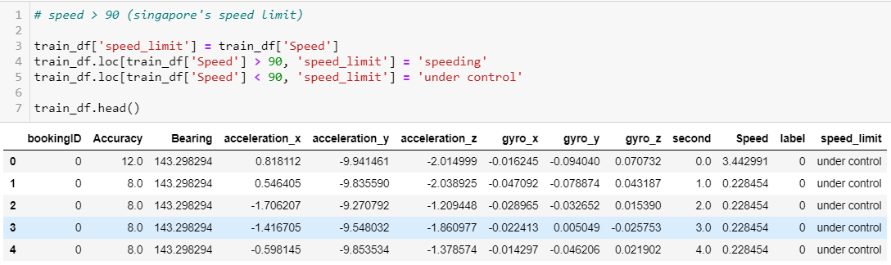
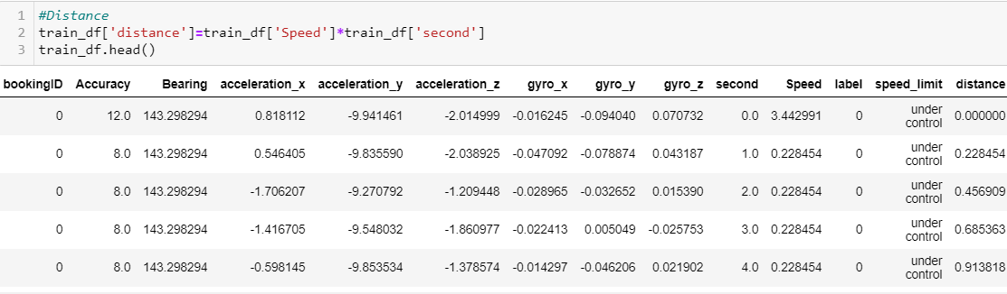
Feature Engineering
2
According to Singapore’s Law, speed that is higher than 90km/h is considered as dangerous driving, hence I have categorized them into 2 groups, Speeding and under control.
Distance is being populated to see the total distance that the vehicle has been travelled in a trip.

Slide 9
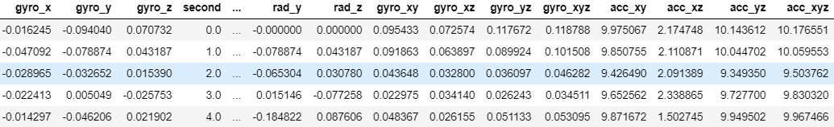
Feature Engineering
2
Randian, Gyro and acceleration data is being transformed based on the vector theorem.

Slide 10
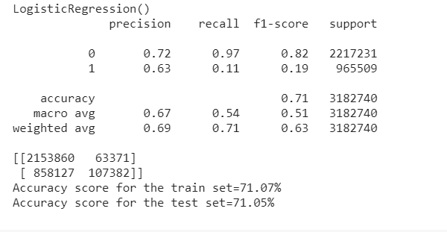
Model Building
4
Logistic Regression

Slide 11
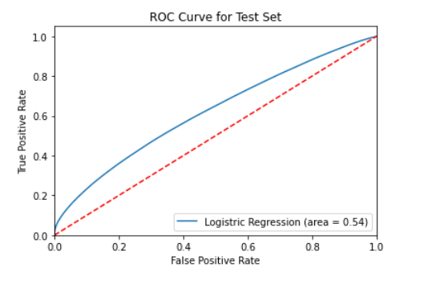
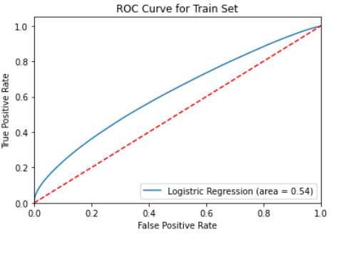
Model Score and Evaluation
4
Logistic Regression

Slide 12
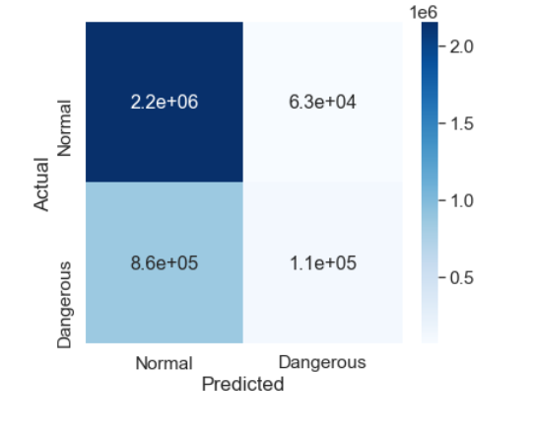
Model Score and Evaluation
4
Logistic Regression

Slide 13
Thank You!

